Slide 1

Department of Information Technology NBA Accredited
A.P. Shah Institute of Technology G.B.Road,Kasarvadavli, Thane(W), Mumbai-400615
UNIVERSITY OF MUMBAI
Academic Year 2020-2021

Slide 2
Weather Forecasting
Submitted in partial fulfilment of the degree of Bachelor of Engineering(Sem-6)
A Project Report on
in
INFORMATION TECHNOLOGY
By
Anurag Singh (19104003)
Atharva Tambde (19104048)
Rajvi Shah (20204001)
Under the Guidance of Prf. Nahid Shaikh

Slide 3
1.Weather Forecasting

Slide 4
1.1 Objectives
To provide user friendly interface for obtaining weather reports.
To automate the process of analysing the weather conditions.
To develop a statistical and analytical report on weather report.
To compare and contrast the different technologies used to gather weather data.
To analyse weather symbols, station models and weather maps.
To describe how weather forecasts are made.

Slide 5
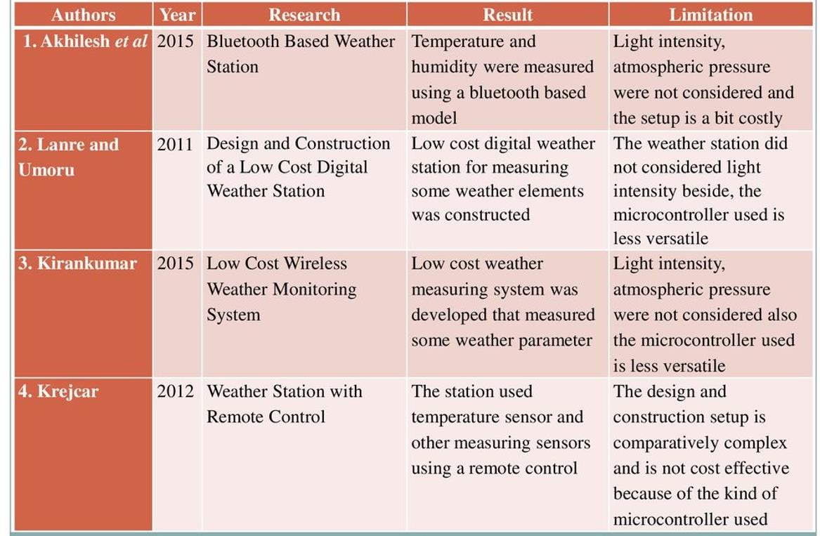
1.2 Literature Review

Slide 6
1.3 Problem Definition
Weather Forecasting sometimes inaccurate.
How accurate are long term forecasts versus short term forecasts?
A fine grid of data is needed to study the accuracy of weather forecasts
PSOC based weather monitoring system can measure environmental data
In urban areas of our country where we have these weather monitoring systems and stations/devices, there are still some constraints; partly due to high cost of importation.

Slide 7
1.4 Scope
One can implement a few more sensors and connect it to the satellite as a global features of the system.
In aircraft, navigation and military there is a great scope of this real-time system.
It can also be implemented in hospitals or medical institutes for the research and study in “Effect of Weather on Health and Diseases”, hence to provide better precaution alerts.

Slide 8
1.5 Technology stack
Python
Pycharm
Anaconda
Db browser Sqlitedb
Django
Visual studio
Bootstrap

Slide 9
2. Project Design

Slide 10
2.1 Proposed System
User will enter the city name and System will take this input data and give the
temperature in degree Celsius as output.
The main role of our system is show the temperatures on the basis of city names.

Slide 11
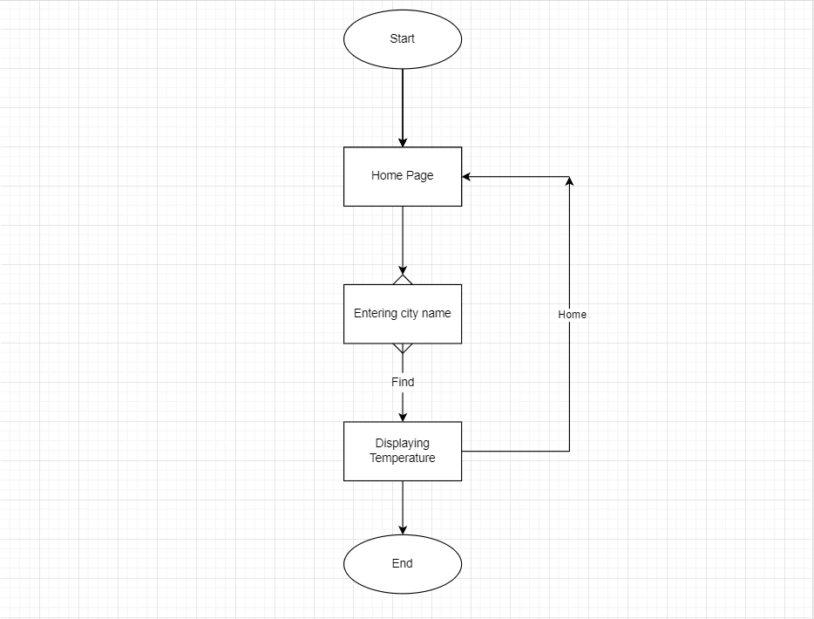
2.2 Design(Flow Of Modules)

Slide 12
3. Implementation

Slide 13
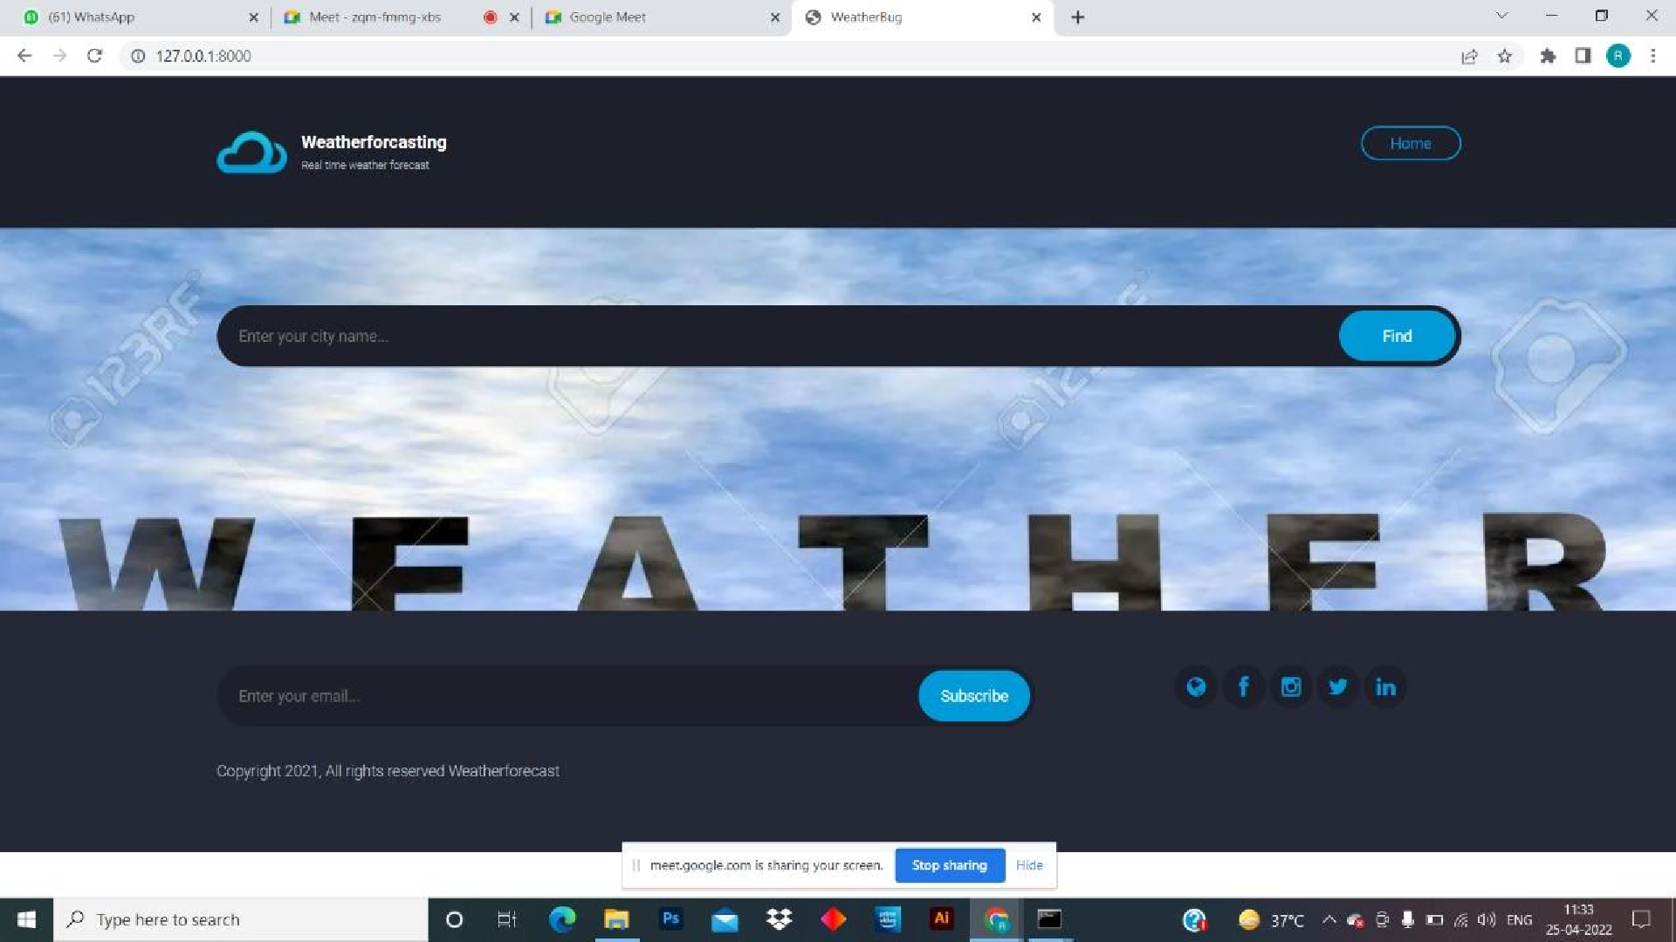

Slide 14
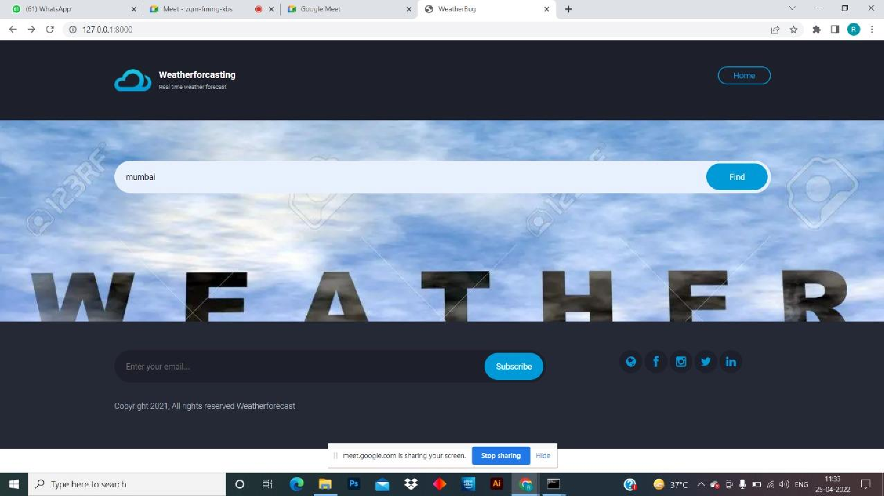

Slide 15
5. Result

Slide 16
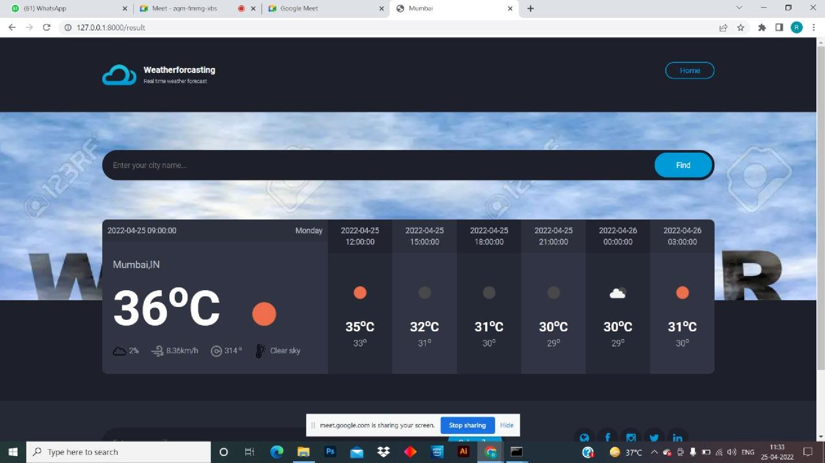

Slide 17
6. Conclusion and Future Scope

Slide 18
Conclusion:
With the advancement of the technology weather forecasting has developed to it level best, but there is yet to develop, as far as a nature is so unpredictable. Natural calamity and weather disturbance causing devasting districtions surprisingly. To save our mother earth scientist and meteorologist are also advancing their knowledge about weather forecasting.

Slide 19
Future Scope:
The features which can be developed in the future are:
One can implement a few more sensors and connect it to the satellite as a
global feature of this system.
Long time (> 7days) weather forecasting by using Zigbee Mesh Technology and covering larger area.
In aircraft, navigation and military there is a great scope of this real-time system.
It can also be implemented in hospitals or medical institutes for the research & study in "Effect of Weather on Health and Diseases", hence to provide better precaution alerts.

Slide 20
References
https://www.tutorialspoint.com/python/python_gui_programming.html
https://github.com/search?q=plagiarism+detector
https://www.educative.io/edpresso/what-is-sequencematcher-in-python

Slide 21
Thank You

